Slide 1
Breast Cancer Prediction
RED Team:
Куценко Антон
Микаелян Айк
Соломоник Михаил
Францев Андрей
Ушел на другой экзамен, который пересекается по времени с защитой >>>> Алексей Сек

Slide 2
Executive Summary: we applied 5 ML methods to predict the diagnosis based on the data about each cell nucleus, which resulted in prediction with more than 95% accuracy
Data Set: Breast Cancer Wisconsin (Diagnostic) Data Set
Task: Binary classification (malignant or benign tumor)
Data: ~30 useful features, 569 rows, 1 useless feature with all NaN values
Models used: Logistic regression, SVM, Gradient Boosting, Random Forest, KNN
Results: We used accuracy as the main metric to compare results. All of the models showed accuracy of more than 95% which is quite unnatural. Actually, this happened due to the fact that data was initially prepared and features were chosen very well
Economic significance: as far as early diagnosis of cancer is incredibly important for its treatment, such ML models can save lives of individuals.
It could result in, for example:
Lower losses of insurance companies (for treatment of late stage diseases)
Decrease costs for companies in which employees suffer from such disease (e.g. they do not need to find a new employee)
For hospitals it will save doctors’ time on diagnosing the type of disease (less working hours)
Source: team analysis

Slide 3
Introduction
Exploratory Data Analysis
Summary of 5 Models

Slide 4
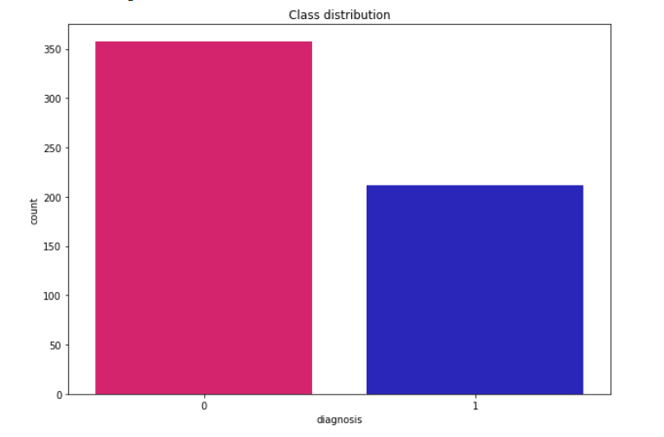
Task and Data
Task: predict whether diagnosis of breast tissues is malignant or benign
Number of features: 30 (mean, standard error and "worst" or largest for each real feature)
All features are numerical
Number of observations: 569
357 benign, 212 malignant
Ten real-valued features are computed for each cell nucleus:
1. radius (mean of distances from center to points on the perimeter)
2. texture (standard deviation of gray-scale values)
3. perimeter
4. area
5. smoothness (local variation in radius lengths)
6. compactness (perimeter^2 / area - 1.0)
7. concavity (severity of concave portions of the contour)
8. concave points (number of concave portions of the contour)
9. symmetry
10. fractal dimension ("coastline approximation" - 1)
Source: team analysis

Slide 5
Introduction
Exploratory Data Analysis
Summary of 5 Models

Slide 6
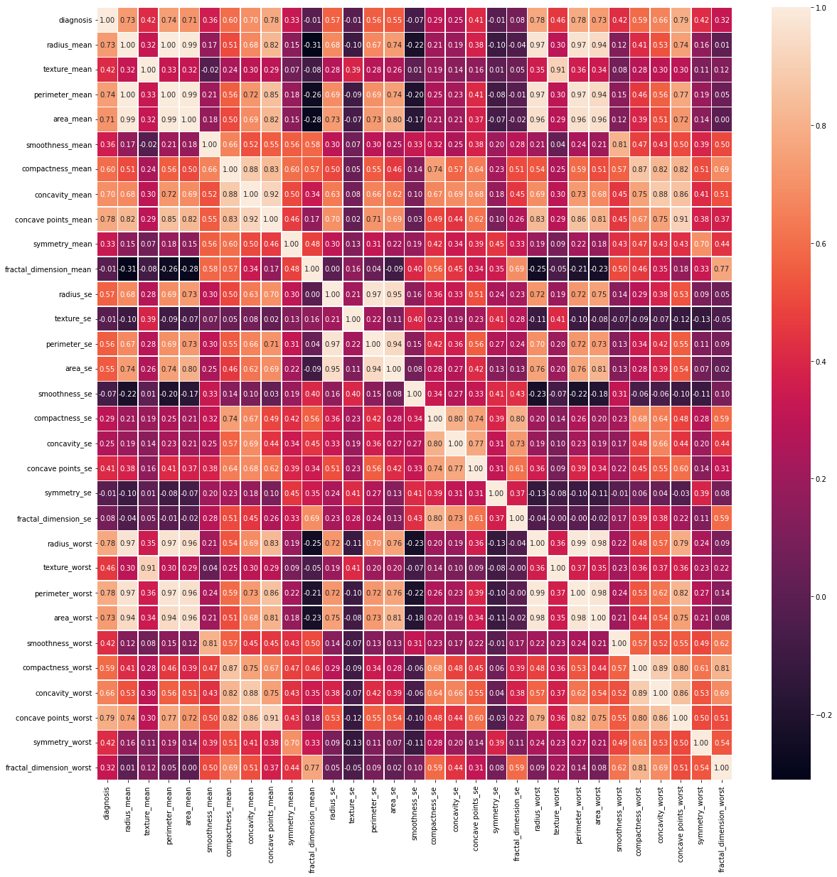
Correlation matrix analysis
From this correlation matrix we can make several conclusions:
Diagnosis has quite high correlations with predictors
Almost all predictors are positively correlated with diagnosis and each other
There is multicollinearity as far as some predictors are strongly correlated with each other
Source: team analysis

Slide 7
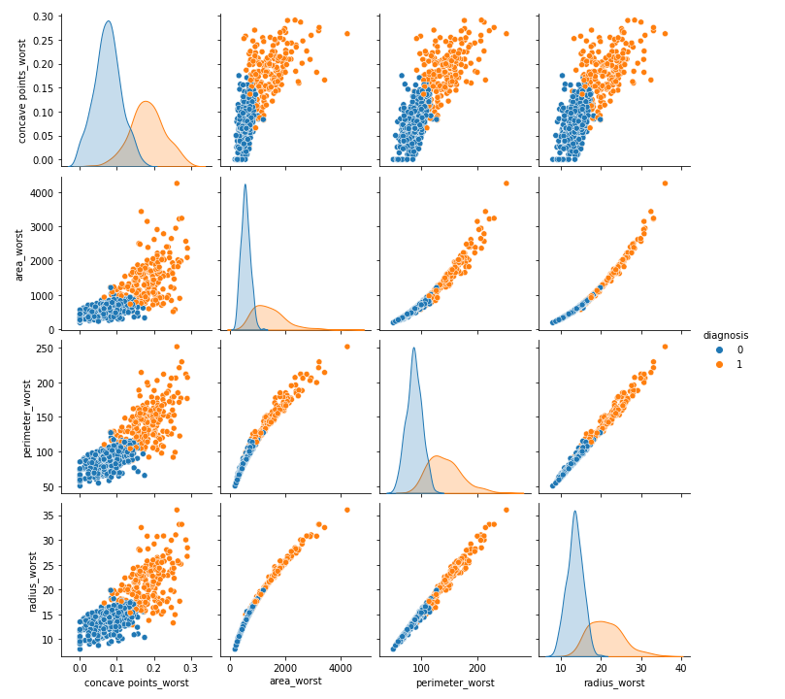
Descriptive statistics
Pair plots analysis
feature | count | mean | std | min | 25% | 50% | 75% | max
diagnosis | 569.0 | 0.372583 | 0.483918 | 0.000000 | 0.000000 | 0.000000 | 1.000000 | 1.00000
radius_mean | 569.0 | 14.127292 | 3.524049 | 6.981000 | 11.700000 | 13.370000 | 15.780000 | 28.11000
texture_mean | 569.0 | 19.289649 | 4.301036 | 9.710000 | 16.170000 | 18.840000 | 21.800000 | 39.28000
perimeter_mean | 569.0 | 91.969033 | 24.298981 | 43.790000 | 75.170000 | 86.240000 | 104.100000 | 188.50000
area_mean | 569.0 | 654.88910 | 351.91412 | 143.50000 | 420.30000 | 551.10000 | 782.700000 | 2501.0000
smoothness_mean | 569.0 | 0.096360 | 0.014064 | 0.052630 | 0.086370 | 0.095870 | 0.105300 | 0.16340
compactness_mean | 569.0 | 0.104341 | 0.052813 | 0.019380 | 0.064920 | 0.092630 | 0.130400 | 0.34540
concavity_mean | 569.0 | 0.088799 | 0.079720 | 0.000000 | 0.029560 | 0.061540 | 0.130700 | 0.42680
concave points_mean | 569.0 | 0.048919 | 0.038803 | 0.000000 | 0.020310 | 0.033500 | 0.074000 | 0.20120
symmetry_mean | 569.0 | 0.181162 | 0.027414 | 0.106000 | 0.161900 | 0.179200 | 0.195700 | 0.30400
fractal_dimension_mean | 569.0 | 0.062798 | 0.007060 | 0.049960 | 0.057700 | 0.061540 | 0.066120 | 0.09744
radius_se | 569.0 | 0.405172 | 0.277313 | 0.111500 | 0.232400 | 0.324200 | 0.478900 | 2.87300
texture_se | 569.0 | 1.216853 | 0.551648 | 0.360200 | 0.833900 | 1.108000 | 1.474000 | 4.88500
perimeter_se | 569.0 | 2.866059 | 2.021855 | 0.757000 | 1.606000 | 2.287000 | 3.357000 | 21.98000
area_se | 569.0 | 40.337079 | 45.491006 | 6.802000 | 17.850000 | 24.530000 | 45.190000 | 542.20000
smoothness_se | 569.0 | 0.007041 | 0.003003 | 0.001713 | 0.005169 | 0.006380 | 0.008146 | 0.03113
compactness_se | 569.0 | 0.025478 | 0.017908 | 0.002252 | 0.013080 | 0.020450 | 0.032450 | 0.13540
concavity_se | 569.0 | 0.031894 | 0.030186 | 0.000000 | 0.015090 | 0.025890 | 0.042050 | 0.39600
concave points_se | 569.0 | 0.011796 | 0.006170 | 0.000000 | 0.007638 | 0.010930 | 0.014710 | 0.05279
symmetry_se | 569.0 | 0.020542 | 0.008266 | 0.007882 | 0.015160 | 0.018730 | 0.023480 | 0.07895
fractal_dimension_se | 569.0 | 0.003795 | 0.002646 | 0.000895 | 0.002248 | 0.003187 | 0.004558 | 0.02984
radius_worst | 569.0 | 16.269190 | 4.833242 | 7.930000 | 13.010000 | 14.970000 | 18.790000 | 36.04000
texture_worst | 569.0 | 25.677223 | 6.146258 | 12.020000 | 21.080000 | 25.410000 | 29.720000 | 49.54000
perimeter_worst | 569.0 | 107.26121 | 33.602542 | 50.410000 | 84.110000 | 97.660000 | 125.400000 | 251.20000
area_worst | 569.0 | 880.5 | 569.3 | 185.2 | 515.3 | 686.5 | 1084.0 | 4254.0
smoothness_worst | 569.0 | 0.132369 | 0.022832 | 0.071170 | 0.116600 | 0.131300 | 0.146000 | 0.22260
compactness_worst | 569.0 | 0.254265 | 0.157336 | 0.027290 | 0.147200 | 0.211900 | 0.339100 | 1.05800
concavity_worst | 569.0 | 0.272188 | 0.208624 | 0.000000 | 0.114500 | 0.226700 | 0.382900 | 1.25200
concave points_worst | 569.0 | 0.114606 | 0.065732 | 0.000000 | 0.064930 | 0.099930 | 0.161400 | 0.29100
symmetry_worst | 569.0 | 0.290076 | 0.061867 | 0.156500 | 0.250400 | 0.282200 | 0.317900 | 0.66380
fractal_dimension_worst | 569.0 | 0.083946 | 0.018061 | 0.055040 | 0.071460 | 0.080040 | 0.092080 | 0.20750
From this Pair plots we can clearly see that using some features it is possible to predict the class even linearly

Slide 8
Introduction
Exploratory Data Analysis
Summary of 5 Models

Slide 9
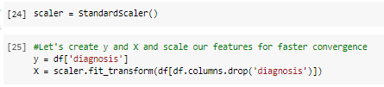
Data preparation
We scaled data using StandardScaler (!)
z = (x - u) / s
u - mean and s - standard deviation
Chosen test set size is 25% of dataset
We split data to train and test sets to check models’ performance after getting best hyperparameters using CV

Slide 10
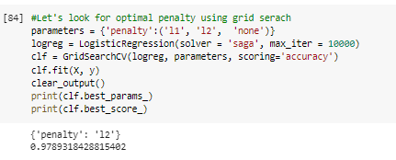
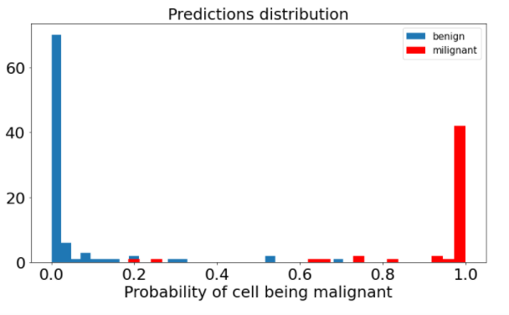
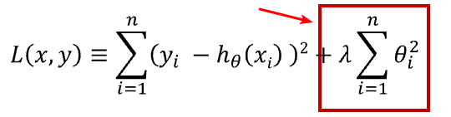
Logistic Regression resulted in accuracy score of 95.8%
Logistic regression is used to predict probability of tissue being malignant
GridSearchCV with default number of folds = 5 is used
to choose best penalty for Logistic Regression
Test set accuracy ~ 95.8%
Best penalty for logreg: l2 norm
Source: team analysis

Slide 11
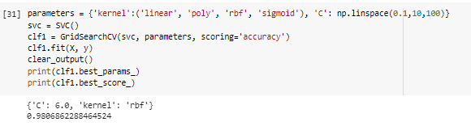
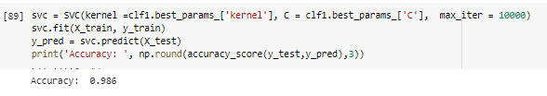
SVM resulted in accuracy score of 98.6%
Support Vector Classifier - looking for hyperplane to maximize margin between classes
Parameters to search for:
Kernel: kernel type to be used in algorithm. Here we choose among linear, polynomial, radial basis function kernel (RBF) and sigmoid kernel
C - Regularization parameter. The strength of the regularization is inversely proportional to C. The penalty is a squared l2 penalty.
Chosen parameters: C= 6 and RBF kernel
Fitting train set with such parameters results in 98.6% accuracy on test set.
Source: team analysis

Slide 12
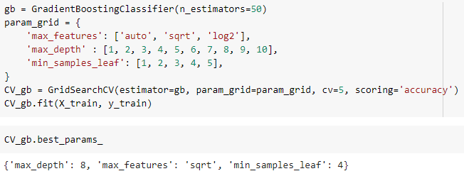
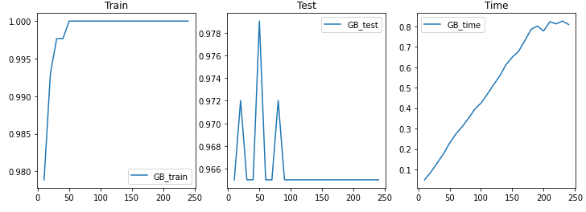
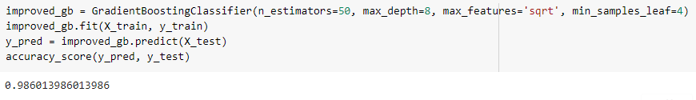
Gradient Boosting resulted in accuracy score of 98.6 %
Gradient boosting produces a prediction model in the form of an ensemble of weak prediction models
First, let's choose the number of boosting stages to perform with graphics.
Then select optimal parameters with cross-validation
Finally, fit the best gradient boosting model with 98.6 % accuracy score
Source: team analysis

Slide 13
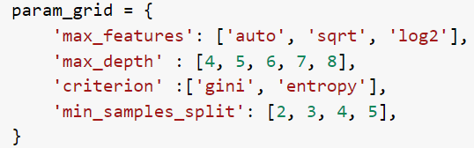
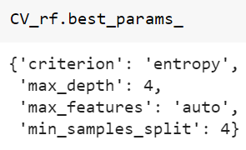
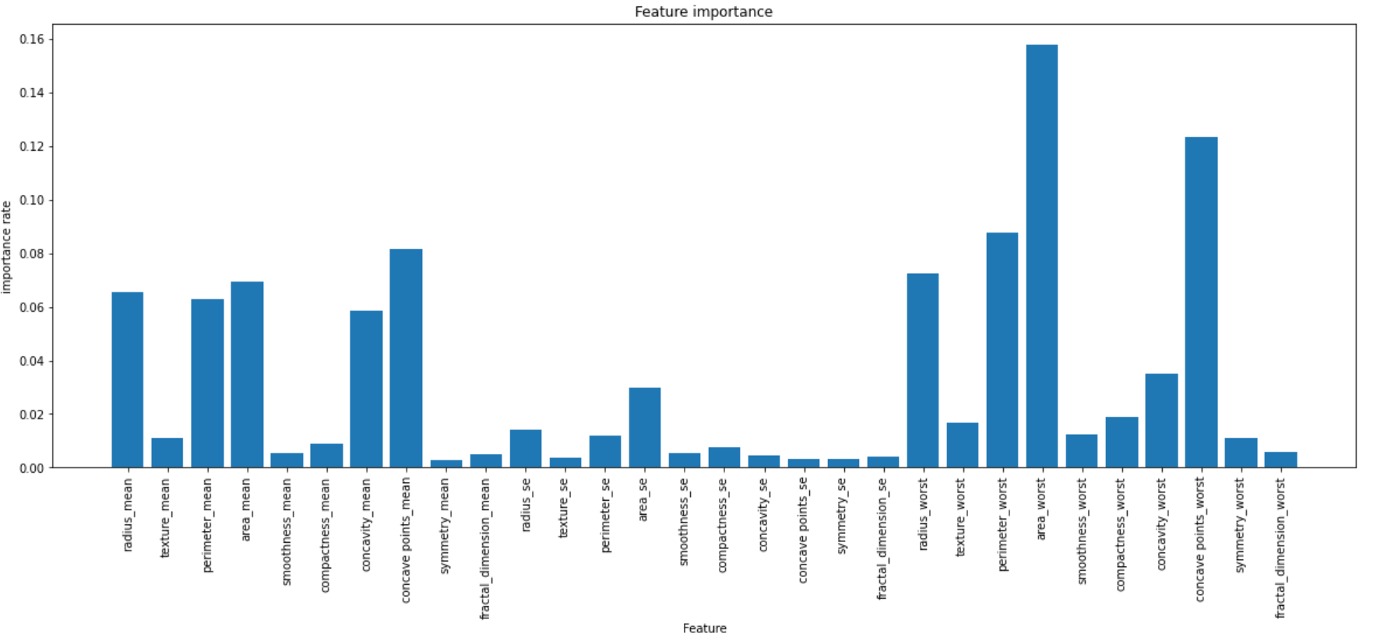
Random Forest resulted in accuracy score of 97.9%
Random forest - a number of the independent trees that work as an ensemble of methods
Cross-validation implementation to search out the optimal values of parameters:
Optimal random forest model construction using the best values of parameters:
Features importances analysis:
getting the most and the least important features
Source: team analysis

Slide 14
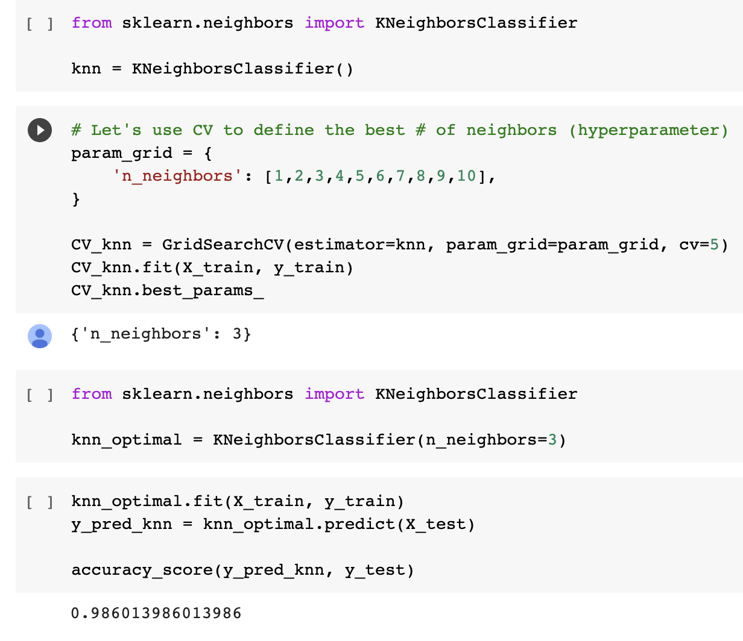
KNN model resulted in accuracy score of 98.6%
Summary:
Another method we tried to leverage was KNN
We used KNN with Cross-Validation to define optimal number of neighbours (hyperparameter)
Tried 1 to 10 neighbours, the best parameter after CV was 3 neighbours
We fitted KNN with 3 neighbours with our train data and made prediction
Accuracy score (Y_predict vs Y_test) ~ 98.6%
Source: team analysis

Slide 15
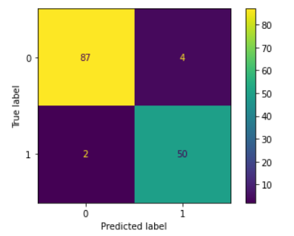
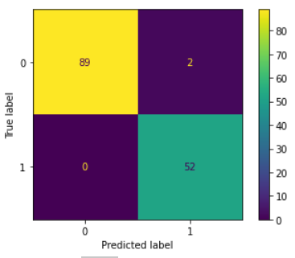
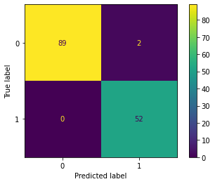


Overall, all models showed very good results because initially data was very well prepared and mostly useful features were taken. There is no clear leader here as far as all models gave very high accuracy
Log Reg
SVM
GB
RF
KNN
Confusion Matrix:
Confusion Matrix:
Confusion Matrix:
Confusion Matrix:
Confusion Matrix:
Accuracy Score: 95.8%
Accuracy Score: 98.6%
Accuracy Score: 98.6%
Accuracy Score: 97.9%
Accuracy Score: 98.6%
Summary: Major of probability predictions are close 0 and 1 and correct. So, logistic regression gives very confident forecasts of tissues being benign and malignant
Summary: Since we see on pairplots that there are features combinations almost perfect separating classes then SVM can be extremely useful
Summary: So the ensemble of weak prediction models does an excellent job of classification and is one of the most powerful predicting methods
Summary: Random forest gave pretty high accuracy score but was outperformed by some other models
Summary:
Though this method is quite simple, on this data it showed quite good results
Source: team analysis

Slide 16
Thank you!

